Slide 1

Data & Backend
Wenxuan Shi
College of Software, Nankai University
Email: shiwx@nankai.edu.cn
Wechat: 13920561100

Slide 2
Topics
State management
Introduction
Think declaratively
Ephemeral vs app state
Simple app state management
Options
Networking & http
JSON and serialization
Firebase

Slide 3
State management
Notes:
StatelessWidget is used for immutable elements that only rely on the object configuration information
StatefulWidget is used for elements that can dynamically change based on state-changes in the system
Everytime that state changes, setChange() is called by the object

Slide 4
Introduction
As you explore Flutter, there comes a time when you need to share application state between screens, across your app.
There are many approaches you can take, and many questions to think about.

Slide 5
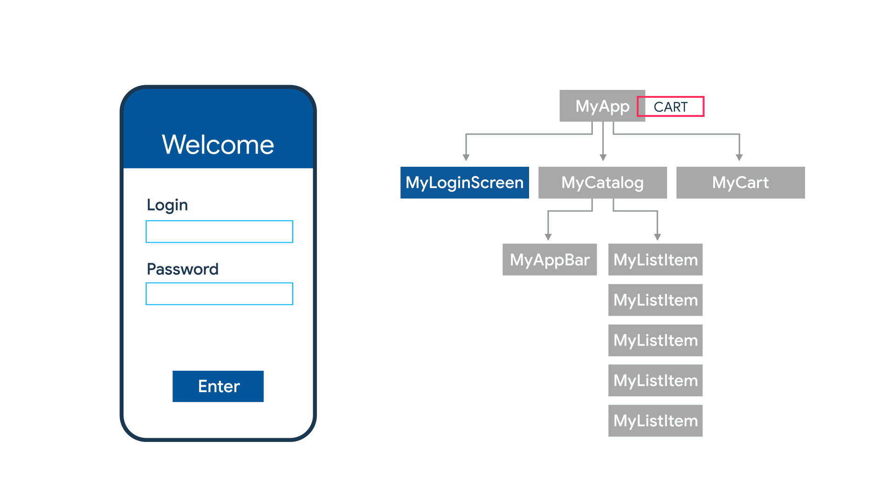

Slide 6
Start thinking declaratively
If you’re coming to Flutter from an imperative framework (such as Android SDK or iOS UIKit), you need to start thinking about app development from a new perspective.
Flutter is declarative. This means that Flutter builds its user interface to reflect the current state of your app:

Slide 7
When the state of your app changes (for example, the user flips a switch in the settings screen), you change the state, and that triggers a redraw of the user interface.
There is no imperative changing of the UI itself (like widget.setText)—you change the state, and the UI rebuilds from scratch.
Read more about the declarative approach to UI programming in the get started guide.

Slide 8
Ephemeral vs app state
This doc introduces app state, ephemeral state, and how you might manage each in a Flutter app.
In the broadest possible sense, the state of an app is everything that exists in memory when the app is running.
This includes the app’s assets, all the variables that the Flutter framework keeps about the UI, animation state, textures, fonts, and so on.

Slide 9
Ephemeral state
Ephemeral state (sometimes called UI state or local state) is the state you can neatly contain in a single widget.
Here are a few examples.
current page in a PageView
current progress of a complex animation
current selected tab in a BottomNavigationBar

Slide 10
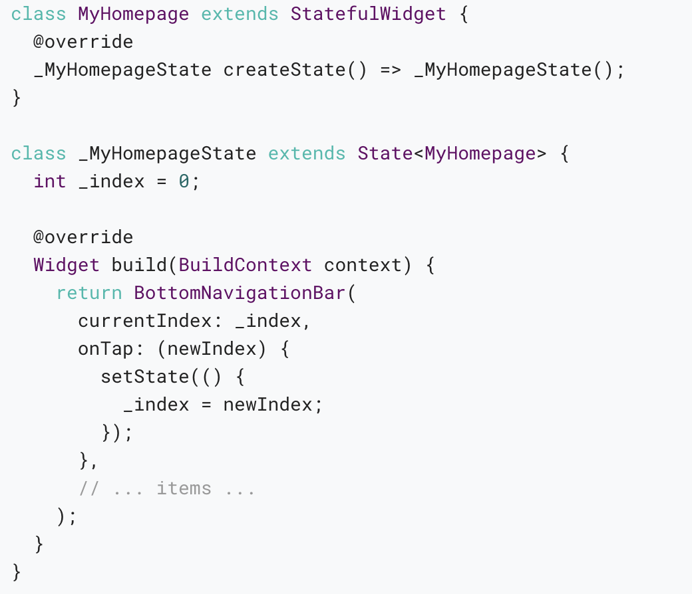
In this example, _index is ephemeral state.
Here, using setState() and a field inside the StatefulWidget’s State class is completely natural.

Slide 11
App state
State that is not ephemeral, that you want to share across many parts of your app, and that you want to keep between user sessions, is what we call application state (sometimes also called shared state).

Slide 12
Examples of application state:
User preferences
Login info
Notifications in a social networking app
The shopping cart in an e-commerce app
Read/unread state of articles in a news app

Slide 13
There is no clear-cut rule
To be clear, you can use State and setState() to manage all of the state in your app.
In fact, the Flutter team does this in many simple app samples (including the starter app that you get with every flutter create).
There is no clear-cut, universal rule to distinguish whether a particular variable is ephemeral or app state. Sometimes, you’ll have to refactor one into another.

Slide 14
For that reason, take the following diagram with a large grain of salt:

Slide 15
The rule of thumb is: Do whatever is less awkward.
In summary, there are two conceptual types of state in any Flutter app.
Both types have their place in any Flutter app, and the split between the two depends on your own preference and the complexity of the app.

Slide 16
Simple app state management
Our example
For illustration, consider the following simple app.
The app has two separate screens: a catalog, and a cart (represented by the MyCatalog, and MyCart widgets, respectively).
It could be a shopping app, but you can imagine the same structure in a simple social networking app (replace catalog for “wall” and cart for “favorites”).

Slide 17
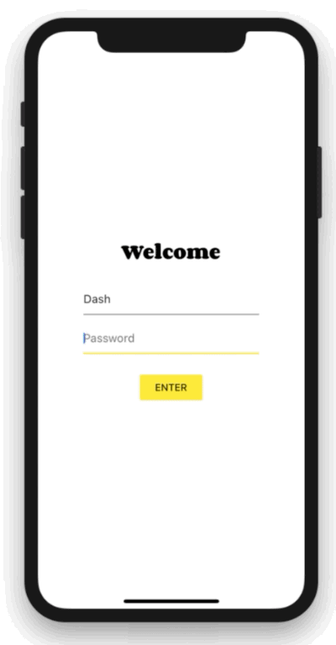
The catalog screen includes a custom app bar (MyAppBar) and a scrolling view of many list items (MyListItems).
Here’s the app visualized as a widget tree.

Slide 18
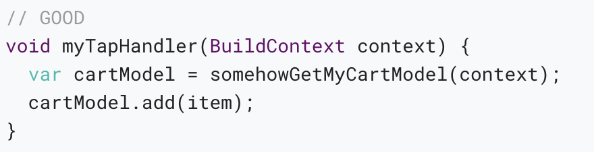
Lifting state up
In Flutter, it makes sense to keep the state above the widgets that use it. Why? In declarative frameworks like Flutter, if you want to change the UI, you have to rebuild it.
In Flutter, you construct a new widget every time its contents change.

Slide 19
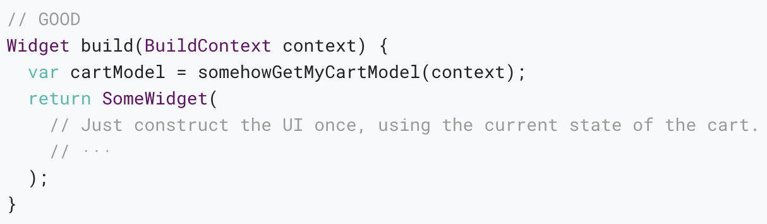
Now MyCart has only one code path for building any version of the UI.

Slide 20
In our example, contents needs to live in MyApp. Whenever it changes, it rebuilds MyCart from above (more on that later).

Slide 21
Accessing the state
When a user clicks on one of the items in the catalog, it’s added to the cart. But since the cart lives above MyListItem, how do we do that?
A simple option is to provide a callback that MyListItem can call when it is clicked.

Slide 22
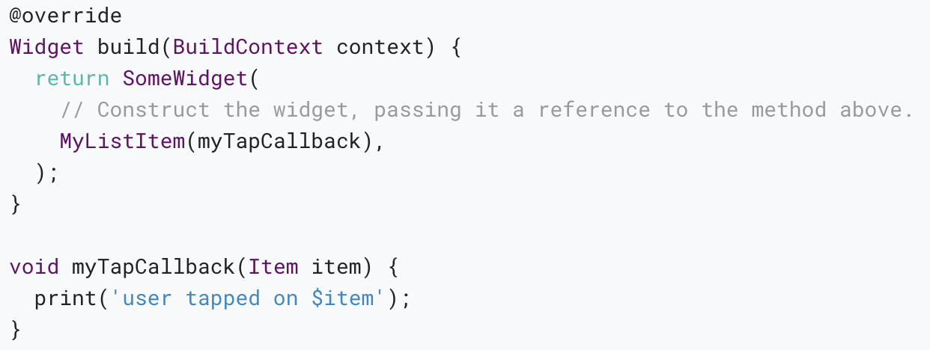
Inside MyCatalog you can define the following:

Slide 23
ChangeNotifier
ChangeNotifier is a simple class included in the Flutter SDK which provides change notification to its listeners.
In other words, if something is a ChangeNotifier, you can subscribe to its changes. (It is a form of Observable, for those familiar with the term.)
In provider, ChangeNotifier is one way to encapsulate your application state.

Slide 24
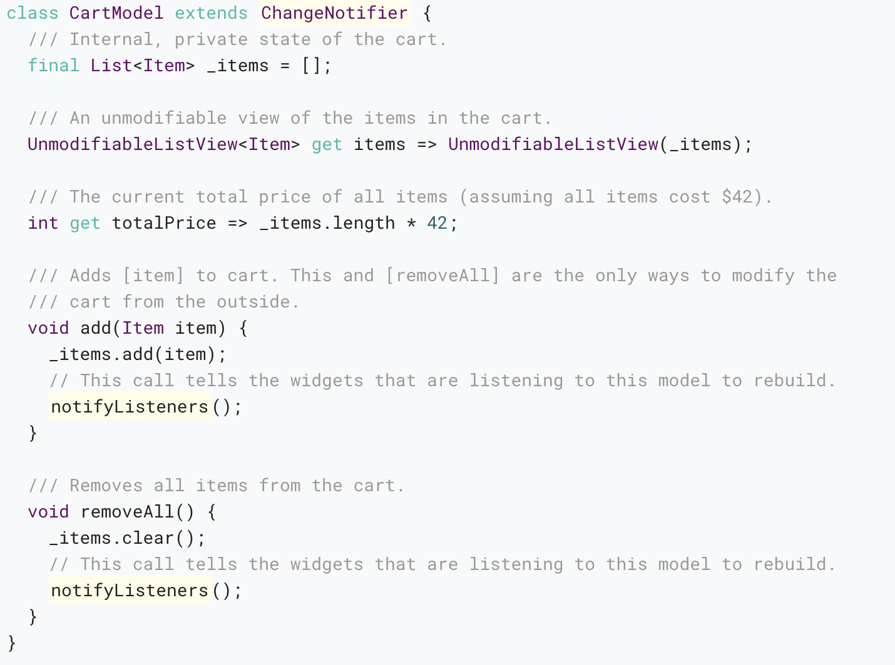
In our shopping app example, we want to manage the state of the cart in a ChangeNotifier.

Slide 25
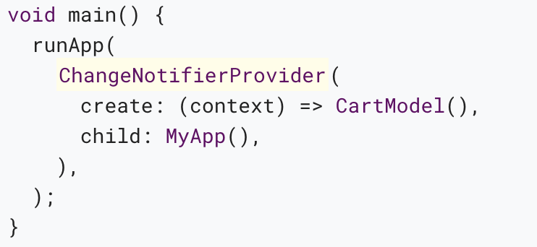
ChangeNotifierProvider
ChangeNotifierProvider is the widget that provides an instance of a ChangeNotifier to its descendants.
It comes from the provider package.

Slide 26
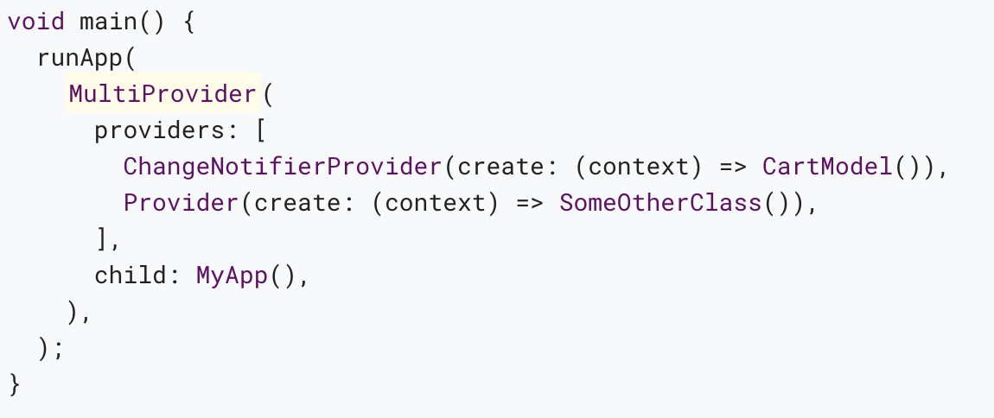
If you want to provide more than one class, you can use MultiProvider:

Slide 27
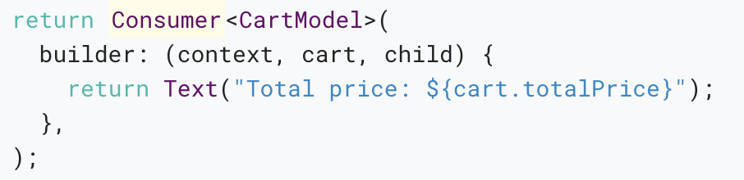
Consumer
Now that CartModel is provided to widgets in our app through the ChangeNotifierProvider declaration at the top, we can start using it.
This is done through the Consumer widget.

Slide 28
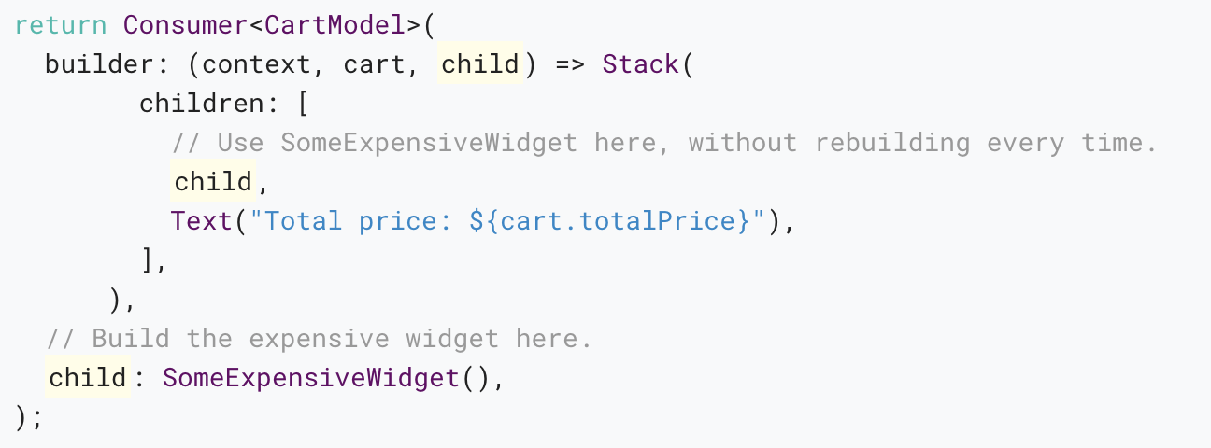
The third argument is child, which is there for optimization.

Slide 29
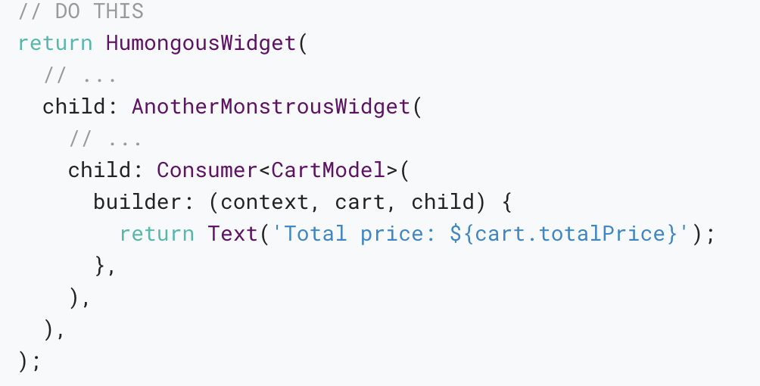
It is best practice to put your Consumer widgets as deep in the tree as possible.

Slide 30
Provider.of
Sometimes, you don’t really need the data in the model to change the UI but you still need to access it.
We could use Consumer<CartModel> for this, but that would be wasteful. We’d be asking the framework to rebuild a widget that doesn’t need to be rebuilt.

Slide 31
Putting it all together
You can check out the example covered in this article.
If you want something simpler, see what the simple Counter app looks like when built with provider.

Slide 32
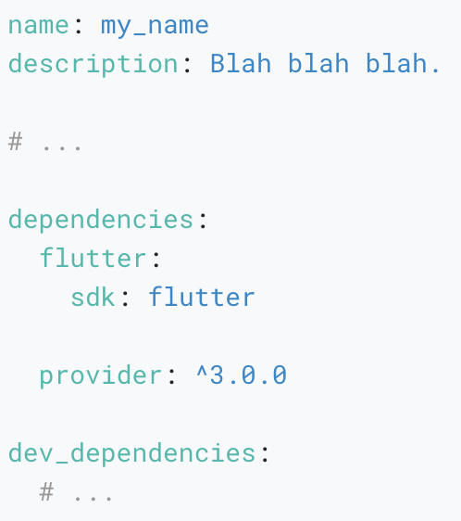
When you’re ready to play around with provider yourself, don’t forget to add the dependency on it to your pubspec.yaml first.

Slide 33
Networking
Notes:
StatelessWidget is used for immutable elements that only rely on the object configuration information
StatefulWidget is used for elements that can dynamically change based on state-changes in the system
Everytime that state changes, setChange() is called by the object

Slide 34
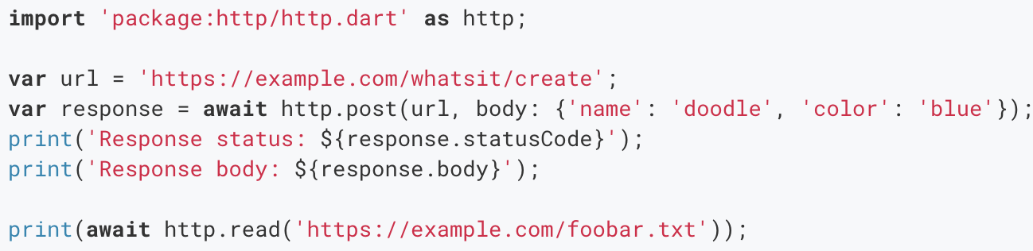
Cross-platform http networking
The http package provides the simplest way to issue http requests. This package is supported on Android, iOS, and the web.
The easiest way to use this library is via the top-level functions. They allow you to make individual HTTP requests with minimal hassle:

Slide 35
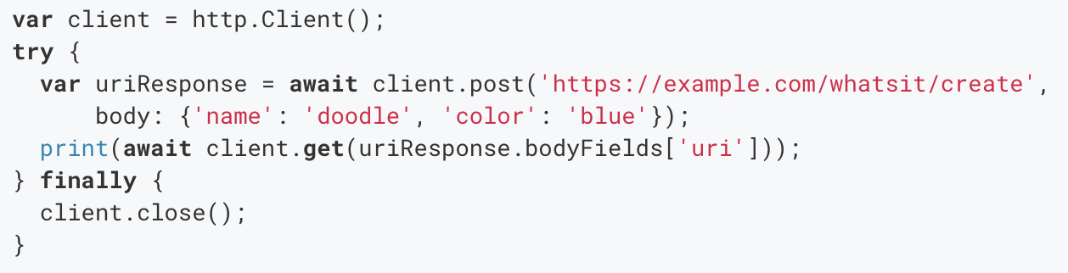
If you're making multiple requests to the same server, you can keep open a persistent connection by using a Client rather than making one-off requests.

Slide 36
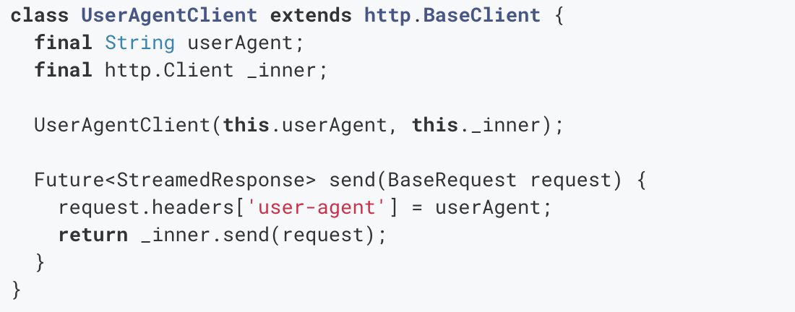
You can also exert more fine-grained control over your requests and responses by creating Request or StreamedRequest objects yourself and passing them to Client.send.

Slide 37
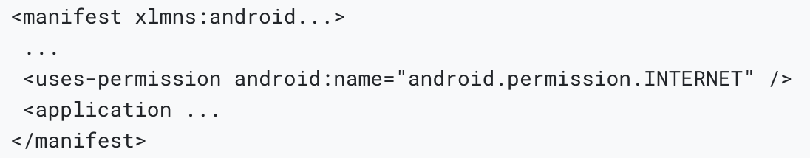
Platform notes
Some platforms require additional steps, as detailed below.
Android apps must declare their use of the internet in the Android manifest (AndroidManifest.xml ):

Slide 38
Samples
For a practical sample of various networking tasks (incl. fetching data, WebSockets, and parsing data in the background) see the networking cookbook.
Delete data on the internet
Fetch data from the internet
Make authenticated requests
Parse JSON in the background
Send data to the internet
Update data over the internet
Work with WebSockets

Slide 39
JSON and serialization
Notes:
StatelessWidget is used for immutable elements that only rely on the object configuration information
StatefulWidget is used for elements that can dynamically change based on state-changes in the system
Everytime that state changes, setChange() is called by the object

Slide 40
Introduction
It is hard to think of a mobile app that doesn’t need to communicate with a web server or easily store structured data at some point.
When making network-connected apps, the chances are that it needs to consume some good old JSON, sooner or later.

Slide 41
Terminology
Encoding and serialization are the same thing—turning a data structure into a string.
Decoding and deserialization are the opposite process—turning a string into a data structure.
However, serialization also commonly refers to the entire process of translating data structures to and from a more easily readable format.

Slide 42
Which JSON serialization method is right for me?
This article covers two general strategies for working with JSON:
Manual serialization
Automated serialization using code generation

Slide 43
Use manual serialization for smaller projects
Manual JSON decoding refers to using the built-in JSON decoder in dart:convert.
It involves passing the raw JSON string to the jsonDecode() function, and then looking up the values you need in the resulting Map<String, dynamic>.

Slide 44
Use code generation for medium to large projects
JSON serialization with code generation means having an external library generate the encoding boilerplate for you.
After some initial setup, you run a file watcher that generates the code from your model classes.

Slide 45
Is there a GSON/Jackson/Moshi equivalent in Flutter?
The simple answer is no.
Such a library would require using runtime reflection, which is disabled in Flutter.
Runtime reflection interferes with tree shaking, which Dart has supported for quite a long time.
With tree shaking, you can “shake off” unused code from your release builds.

Slide 46
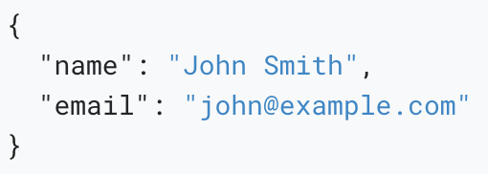
Serializing JSON manually using dart:convert
Basic JSON serialization in Flutter is very simple.
Flutter has a built-in dart:convert library that includes a straightforward JSON encoder and decoder.
The following sample JSON implements a simple user model.

Slide 47
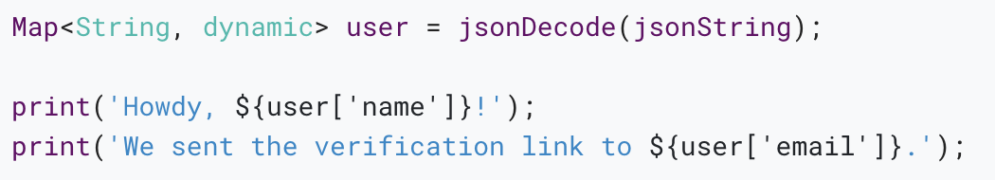
Serializing JSON inline
By looking at the dart:convert documentation, you’ll see that you can decode the JSON by calling the jsonDecode() function, with the JSON string as the method argument.

Slide 48
Serializing JSON inside model classes
Combat the previously mentioned problems by introducing a plain model class, called User in this example. Inside the User class, you’ll find:
A User.fromJson() constructor, for constructing a new User instance from a map structure.
A toJson() method, which converts a User instance into a map.

Slide 49
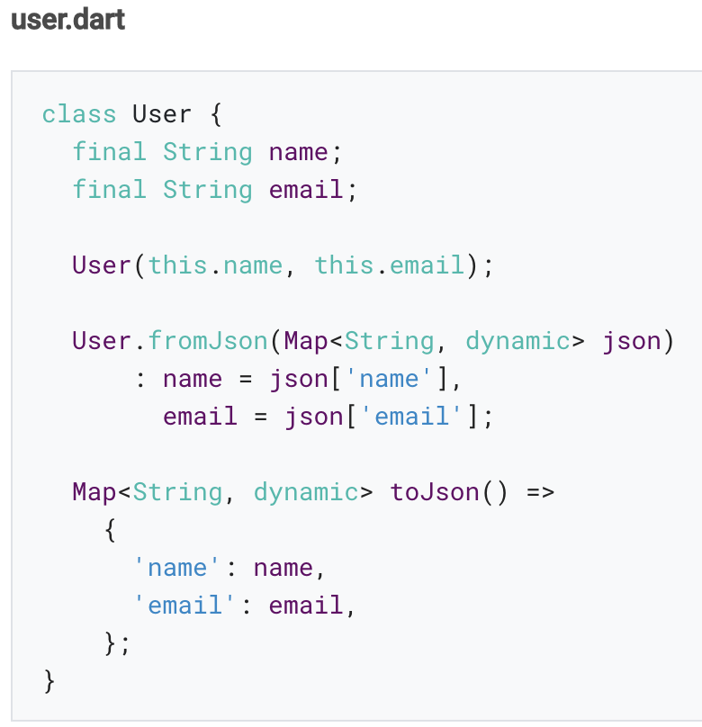
With this approach, the calling code can have type safety, autocompletion for the name and email fields, and compile-time exceptions.

Slide 50
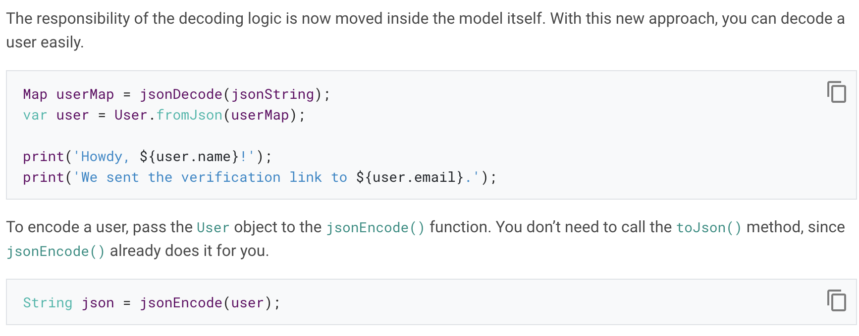

Slide 51
Serializing JSON using code generation libraries
Although there are other libraries available, this guide uses json_serializable, an automated source code generator that generates the JSON serialization boilerplate for you.
Since the serialization code is not handwritten or maintained manually anymore, you minimize the risk of having JSON serialization exceptions at runtime.

Slide 52
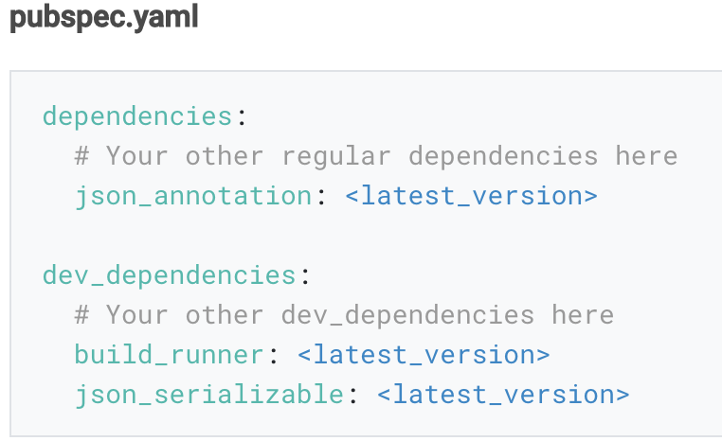
Setting up json_serializable in a project
To include json_serializable in your project, you need one regular dependency, and two dev dependencies.

Slide 53
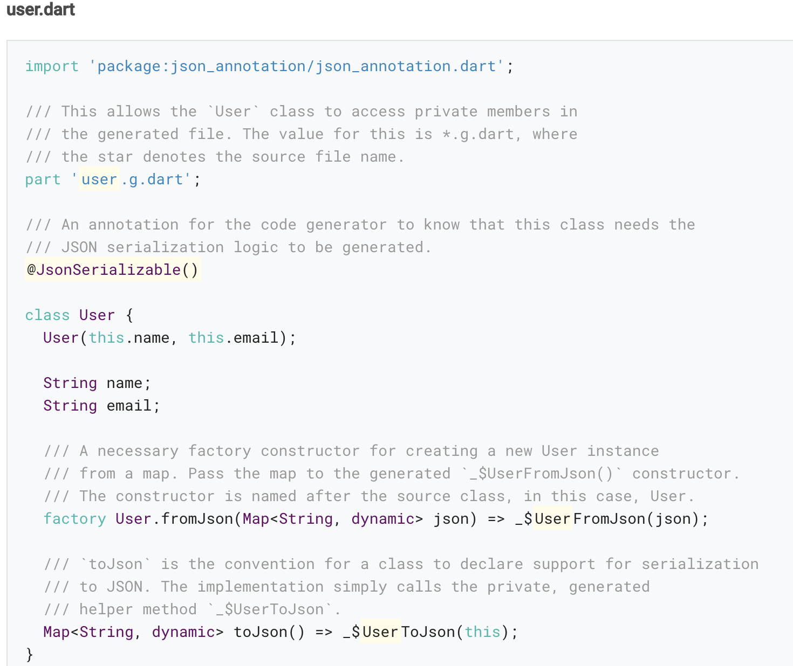
Creating model classes the json_serializable way
The following shows how to convert the User class to a json_serializable class.

Slide 54
Running the code generation utility
When creating json_serializable classes the first time, you’ll get errors similar to what is shown in the image below.
These errors are entirely normal and are simply because the generated code for the model class does not exist yet. To resolve this, run the code generator that generates the serialization boilerplate.

Slide 55
There are two ways of running the code generator.
One-time code generation: By running flutter pub run build_runner build in the project root, you generate JSON serialization code for your models whenever they are needed.
Generating code continuously: A watcher makes our source code generation process more convenient. Start the watcher by running flutter pub run build_runner watch in the project root.

Slide 56
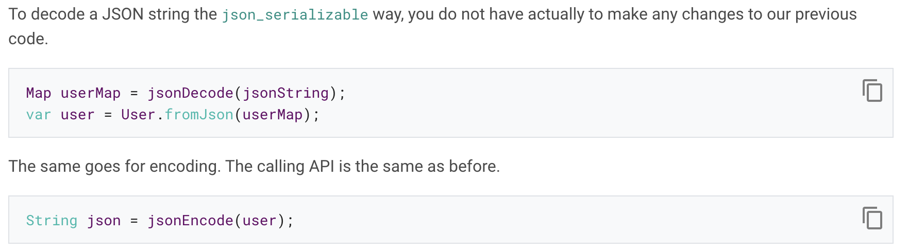
Consuming json_serializable models

Slide 57
Generating code for nested classes
You might have code that has nested classes within a class.
If that is the case, and you have tried to pass the class in JSON format as an argument to a service (such as Firebase, for example), you might have experienced an Invalid argument error.
To make this work, pass explicitToJson: true in the @JsonSerializable() annotation over the class declaration.

Slide 58
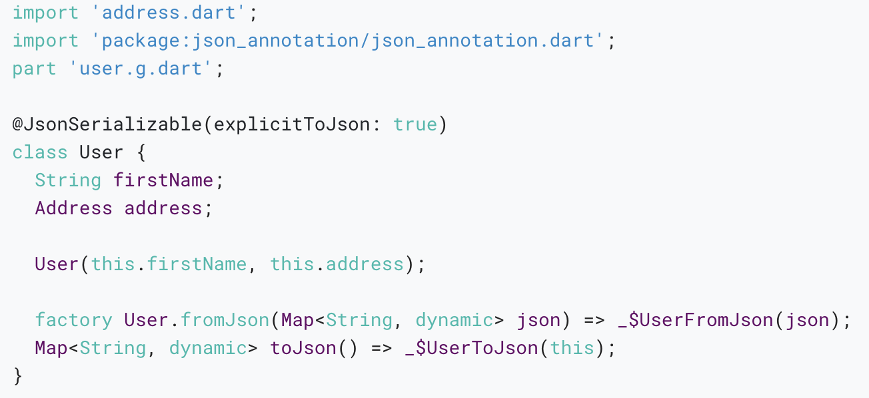
The User class now looks as follows:

Slide 59
Further references
The dart:convert and JsonCodec documentation
The json_serializable package on pub.dev
The json_serializable examples on GitHub

Slide 60
Firebase
Notes:
StatelessWidget is used for immutable elements that only rely on the object configuration information
StatefulWidget is used for elements that can dynamically change based on state-changes in the system
Everytime that state changes, setChange() is called by the object

Slide 61
Introduction
Firebase is a Backend-as-a-Service (BaaS) app development platform that provides hosted backend services such as a realtime database, cloud storage, authentication, crash reporting, machine learning, remote configuration, and hosting for your static files.

Slide 62
Firebase supports Flutter. For more information, see:
Getting started with Firebase and Flutter in the Firebase docs
Firebase for Flutter codelab
Use Firebase to host your Flutter app on the web
FlutterFire plugins

Slide 63
Also, the Flutter community has created docs and videos that you might find useful:
Building chat app with Flutter and Firebase
Using Firestore as a backend to your Flutter app (video)
Live Coding Firebase Authentication with Flutter (video)
Flutter & Firebase Auth 01 (video)
Flutter: Firebase Tutorial Part 1 - Auth and Sign in (video)

Slide 64
Thank you!
Wenxuan Shi
College of Software, Nankai University
Email: shiwx@nankai.edu.cn
Wechat: 13920561100

